Slide 1
Leadership Howard County 2020 DFRS - Special Operations John Zour - Captain

Slide 2
Special operations, what do we do in 2020?
Tesla?
Wifi pole?
Bulk/alternative fuel?
Storm drain?
Overdose?
Heavy vehicles?
Sediment pond?
Construction site?
Cancer procedure?
Hazardous atmosphere?
Floating vehicles?
High speed/technology?
Trains, planes & autos?
Infrastructure impact?
Hazards?

Slide 3
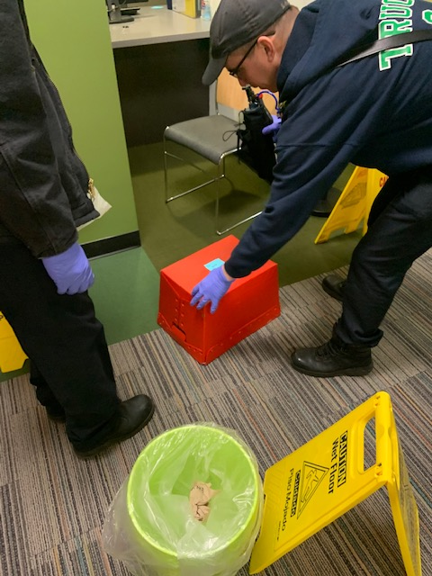
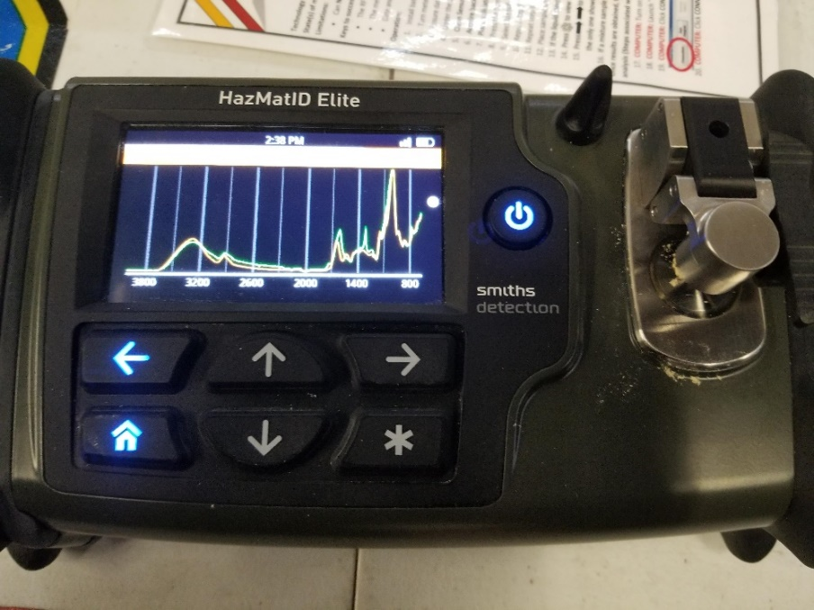
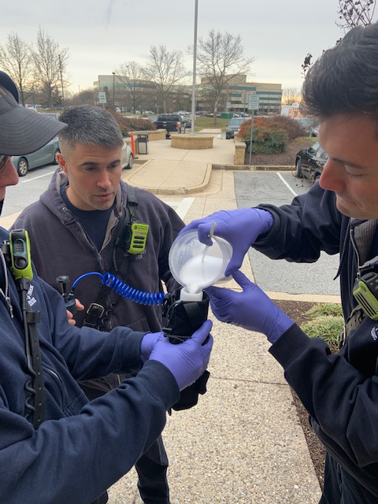
Potent opioids

Slide 4
Potent opioids

Slide 5
Suspicious packages

Slide 6
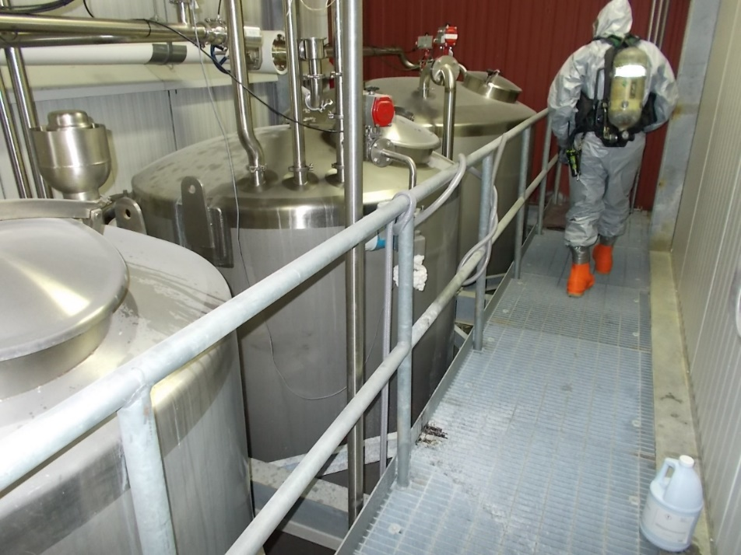
Hazardous materials

Slide 7
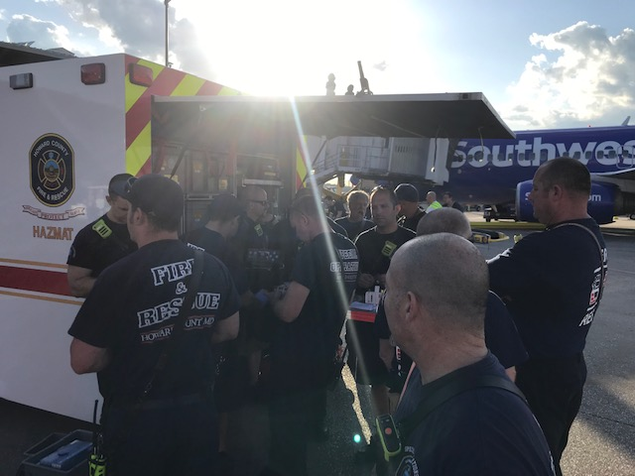
Biological

Slide 8
Bulk fuel

Slide 9
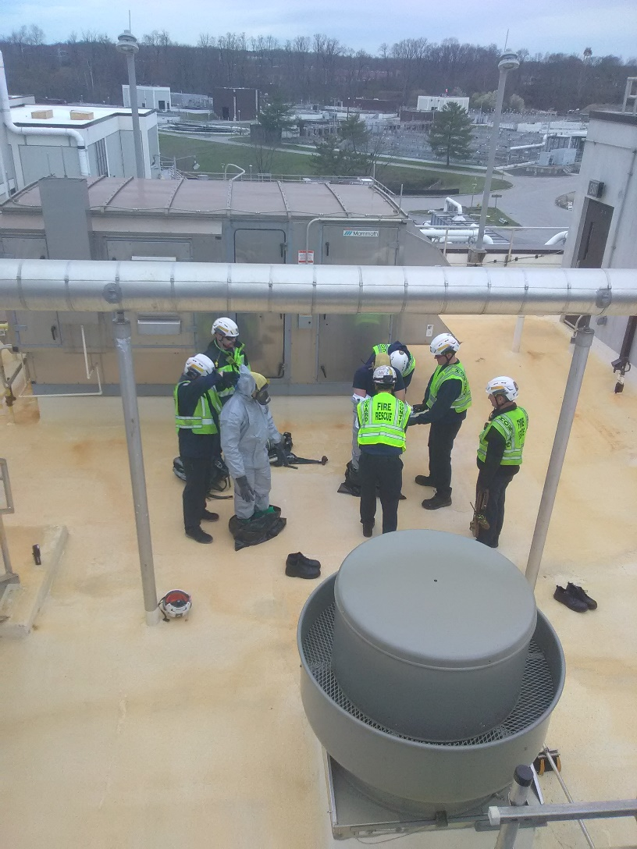
Infrastructure

Slide 10
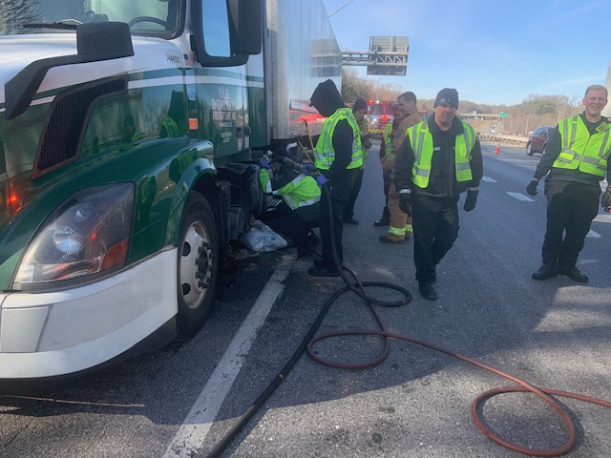
Spills

Slide 11
MD-HART

Slide 12
Floods

Slide 13
Trench

Slide 14
High Speed Collision (NCT)

Slide 15
Collapse

Slide 16
Collapse

Slide 17
Collapse

Slide 18
Tech rope

Slide 19
Entanglement

Slide 20
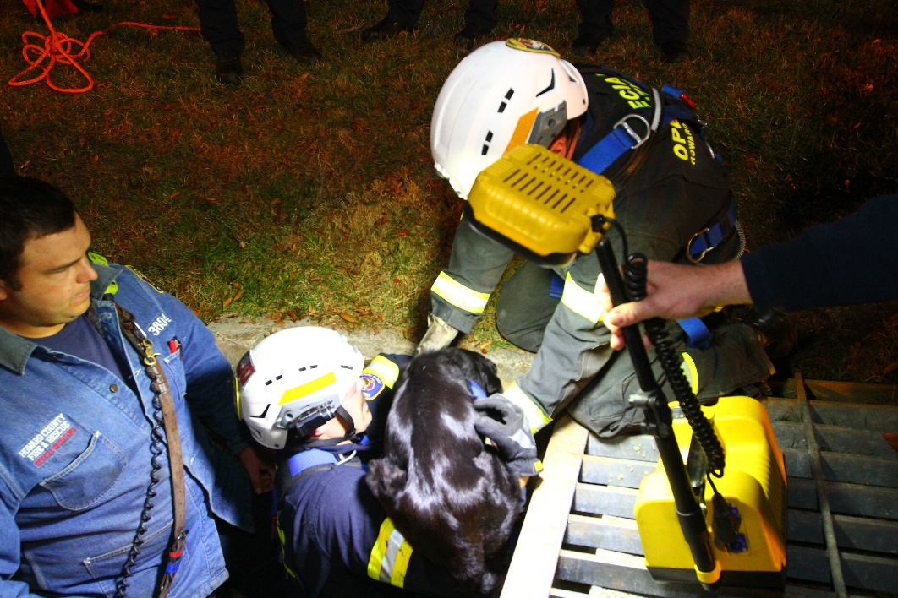
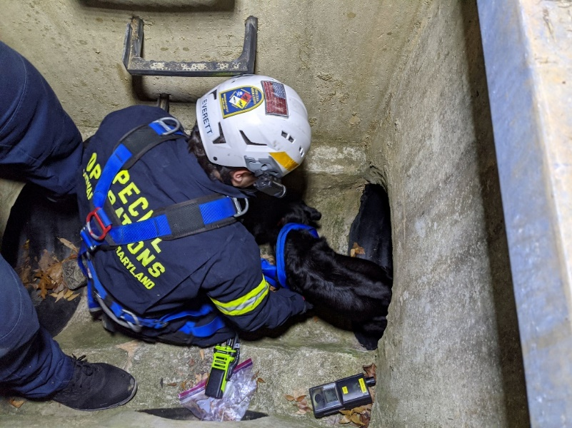
Confined space

Slide 21
Search

Slide 22
Paul Combs

Slide 23
2019 Statistics

