Slide 1
Howard County Police Department
sUAS Program

Slide 2
HCPD sUAS Field Test
Exploring the use of Small Unmanned Aircraft Systems (sUAS), commonly referred to as “Drones”.
Field test will be conducted over the course of one year.
Seven Officers and four Supervisors/Commanders have been trained and authorized to participate in the field test.
All eleven have obtained a remote pilot license under Title 14 of the Code of Federal Regulations (CFR) part 107, Small Unmanned Aircraft Systems

Slide 3
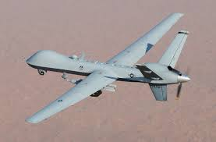
What is a sUAS?
Not this…

Slide 4
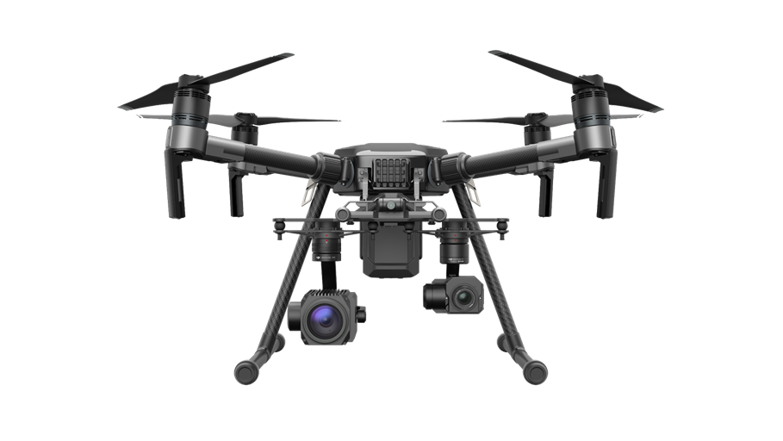
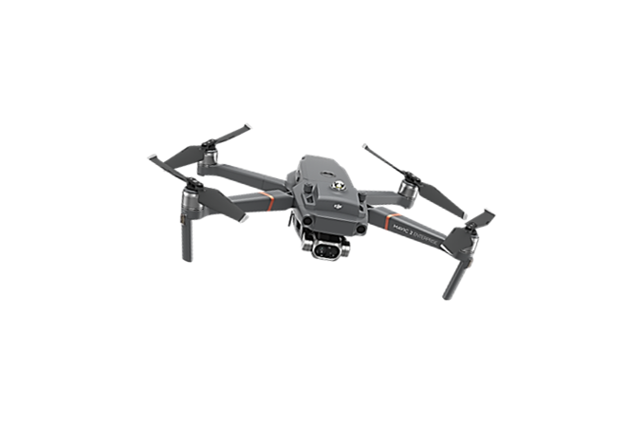
What is a sUAS?
The word “small” is key…
A sUAS is defined as weighing less than 55 lbs.

Slide 5
HCPD Policy
Use of sUAS (drones) are limited to specific law enforcement situations:
Situational Awareness/Management
Search and Rescue
Scene Documentation
Training Support
Public Awareness

Slide 6
Safety is Paramount
We operate within all FAA regulations under Part 107
Flights take place below 400 feet above ground level.
Must have 3 statute miles visibility.
Must have 500 ft. of clearance below cloud ceiling (2000 ft. horizontally).
Must maintain Visual Line of Sight (VLOS) of the drone.
Drone must weigh less than 55 lbs.
Can only fly during daylight (a Waiver has been obtained to allow night flight).
Must operate at a speed under 87 knots (100 mph).
No operation over people (unless they are a crew member).
All other aircraft have right-of-way.

Slide 7
Safety is Paramount
Measures have been implemented to ensure safe operations:
Monthly pilot training.
Department wide Visual Observer training.
Mandatory pre-flight checklists.
Automated maintenance schedules for all equipment.

Slide 8
Preservation of Citizen Privacy
Our policy follows the ACLU Recommendations for Government use of Drones
The sUAS shall not be used to:
Target a person based solely on individual characteristics including but not limited to race, ethnicity, national origin, religion, disability, gender, or sexual orientation.
Harass, intimidate, or discriminate against any individual or group.

Slide 9
Preservation of Citizen Privacy
Drones are used only for training and missions with defined incident parameters and objectives.
Not used for random surveillance.
Recordings and photos are only taken in limited circumstances.
i.e. When they will be used as evidence or training aids
Some video/photos are taken for our Public Information office

Slide 10
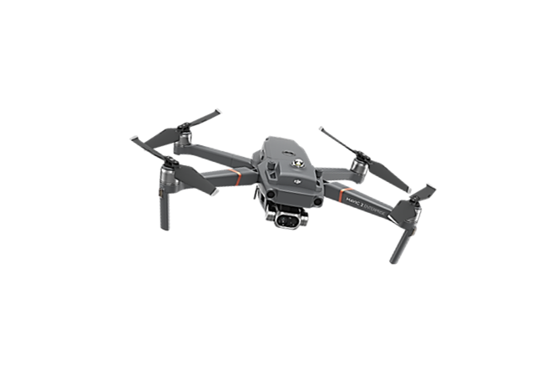
What we are using
DJI-Mavic 2 Enterprise Dual
4K Visual Camera
Flir infrared thermal camera
Pros
Compact and easy to keep in a patrol car all day
Very quick deployment
Can equip a loud speaker or spot light
Cons
No ability to zoom the camera
Flir quality is good; not great

Slide 11
What we are using
DJI-Matrice 210 V2
Zenmuse Z30 (zoom camera)
Zenmuse XT2 Flir (thermal camera)
Pros
Increased ability to zoom with Z30
XT2 is a superior thermal camera compared to the Mavic
Cons
Less compact; more difficult to transport in a patrol vehicle
More set up required to deploy compared to Mavic

Slide 12
Usage as of May 2020
21 operational deployments w/ 37 actual flights
Deployments for numerous types of calls
Barricades, Missing persons, Shooting, Stabbings, Carjackings, Stolen Vehicles, Malicious Burns, Rapes
Have been deployed during the Covid-19 pandemic to respond to calls for executive order violations from a safe distance
115 training flights
13 administrative deployments
Public presentations/demos, PIO requests, Deer management surveys, Traffic mapping

Slide 13
Any Questions?

