Slide 1
When a Pandemic Hits Home
HCDFRS’ Commitment to Service
Matthew J. Levy, DO, MSc, FACEP, FAEMS, NRP
Medical Director, Howard County
Department of Fire & Rescue Services Associate Professor of Emergency Medicine,
Johns Hopkins University

Slide 2
Disclaimer
Any opinion(s) conveyed here are my own and do not represent those of any institution, agency or body of government
This information does not supersede public health recommendations
Notes:
Before we begin, we do need to review a few disclaimers; (read slide)
We will answer questions based upon CDC recommendations, and stress the caveat that it is ultimately at the discretion of your agency’s medical director and leadership.
\\
We will answer questions based upon CDC recommendations, and stress the caveat that it is ultimately at the discretion of your agency’s medical director and leadership.

Slide 3
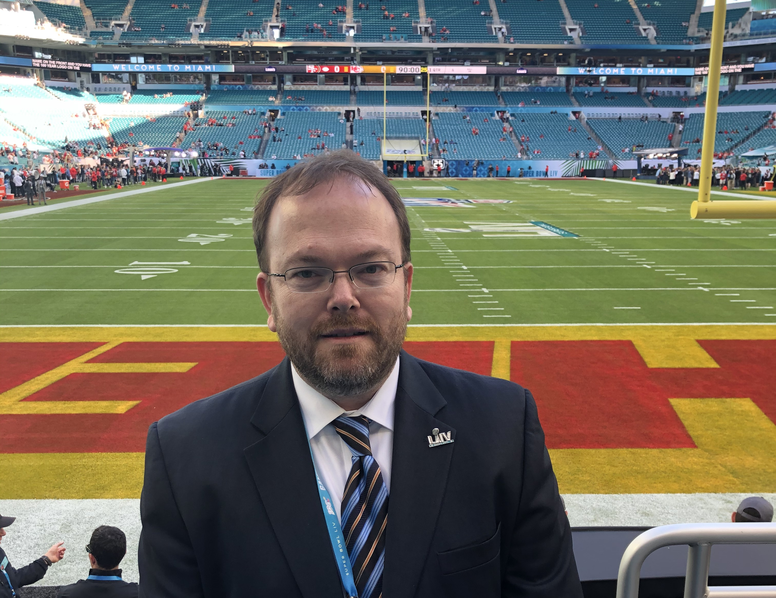
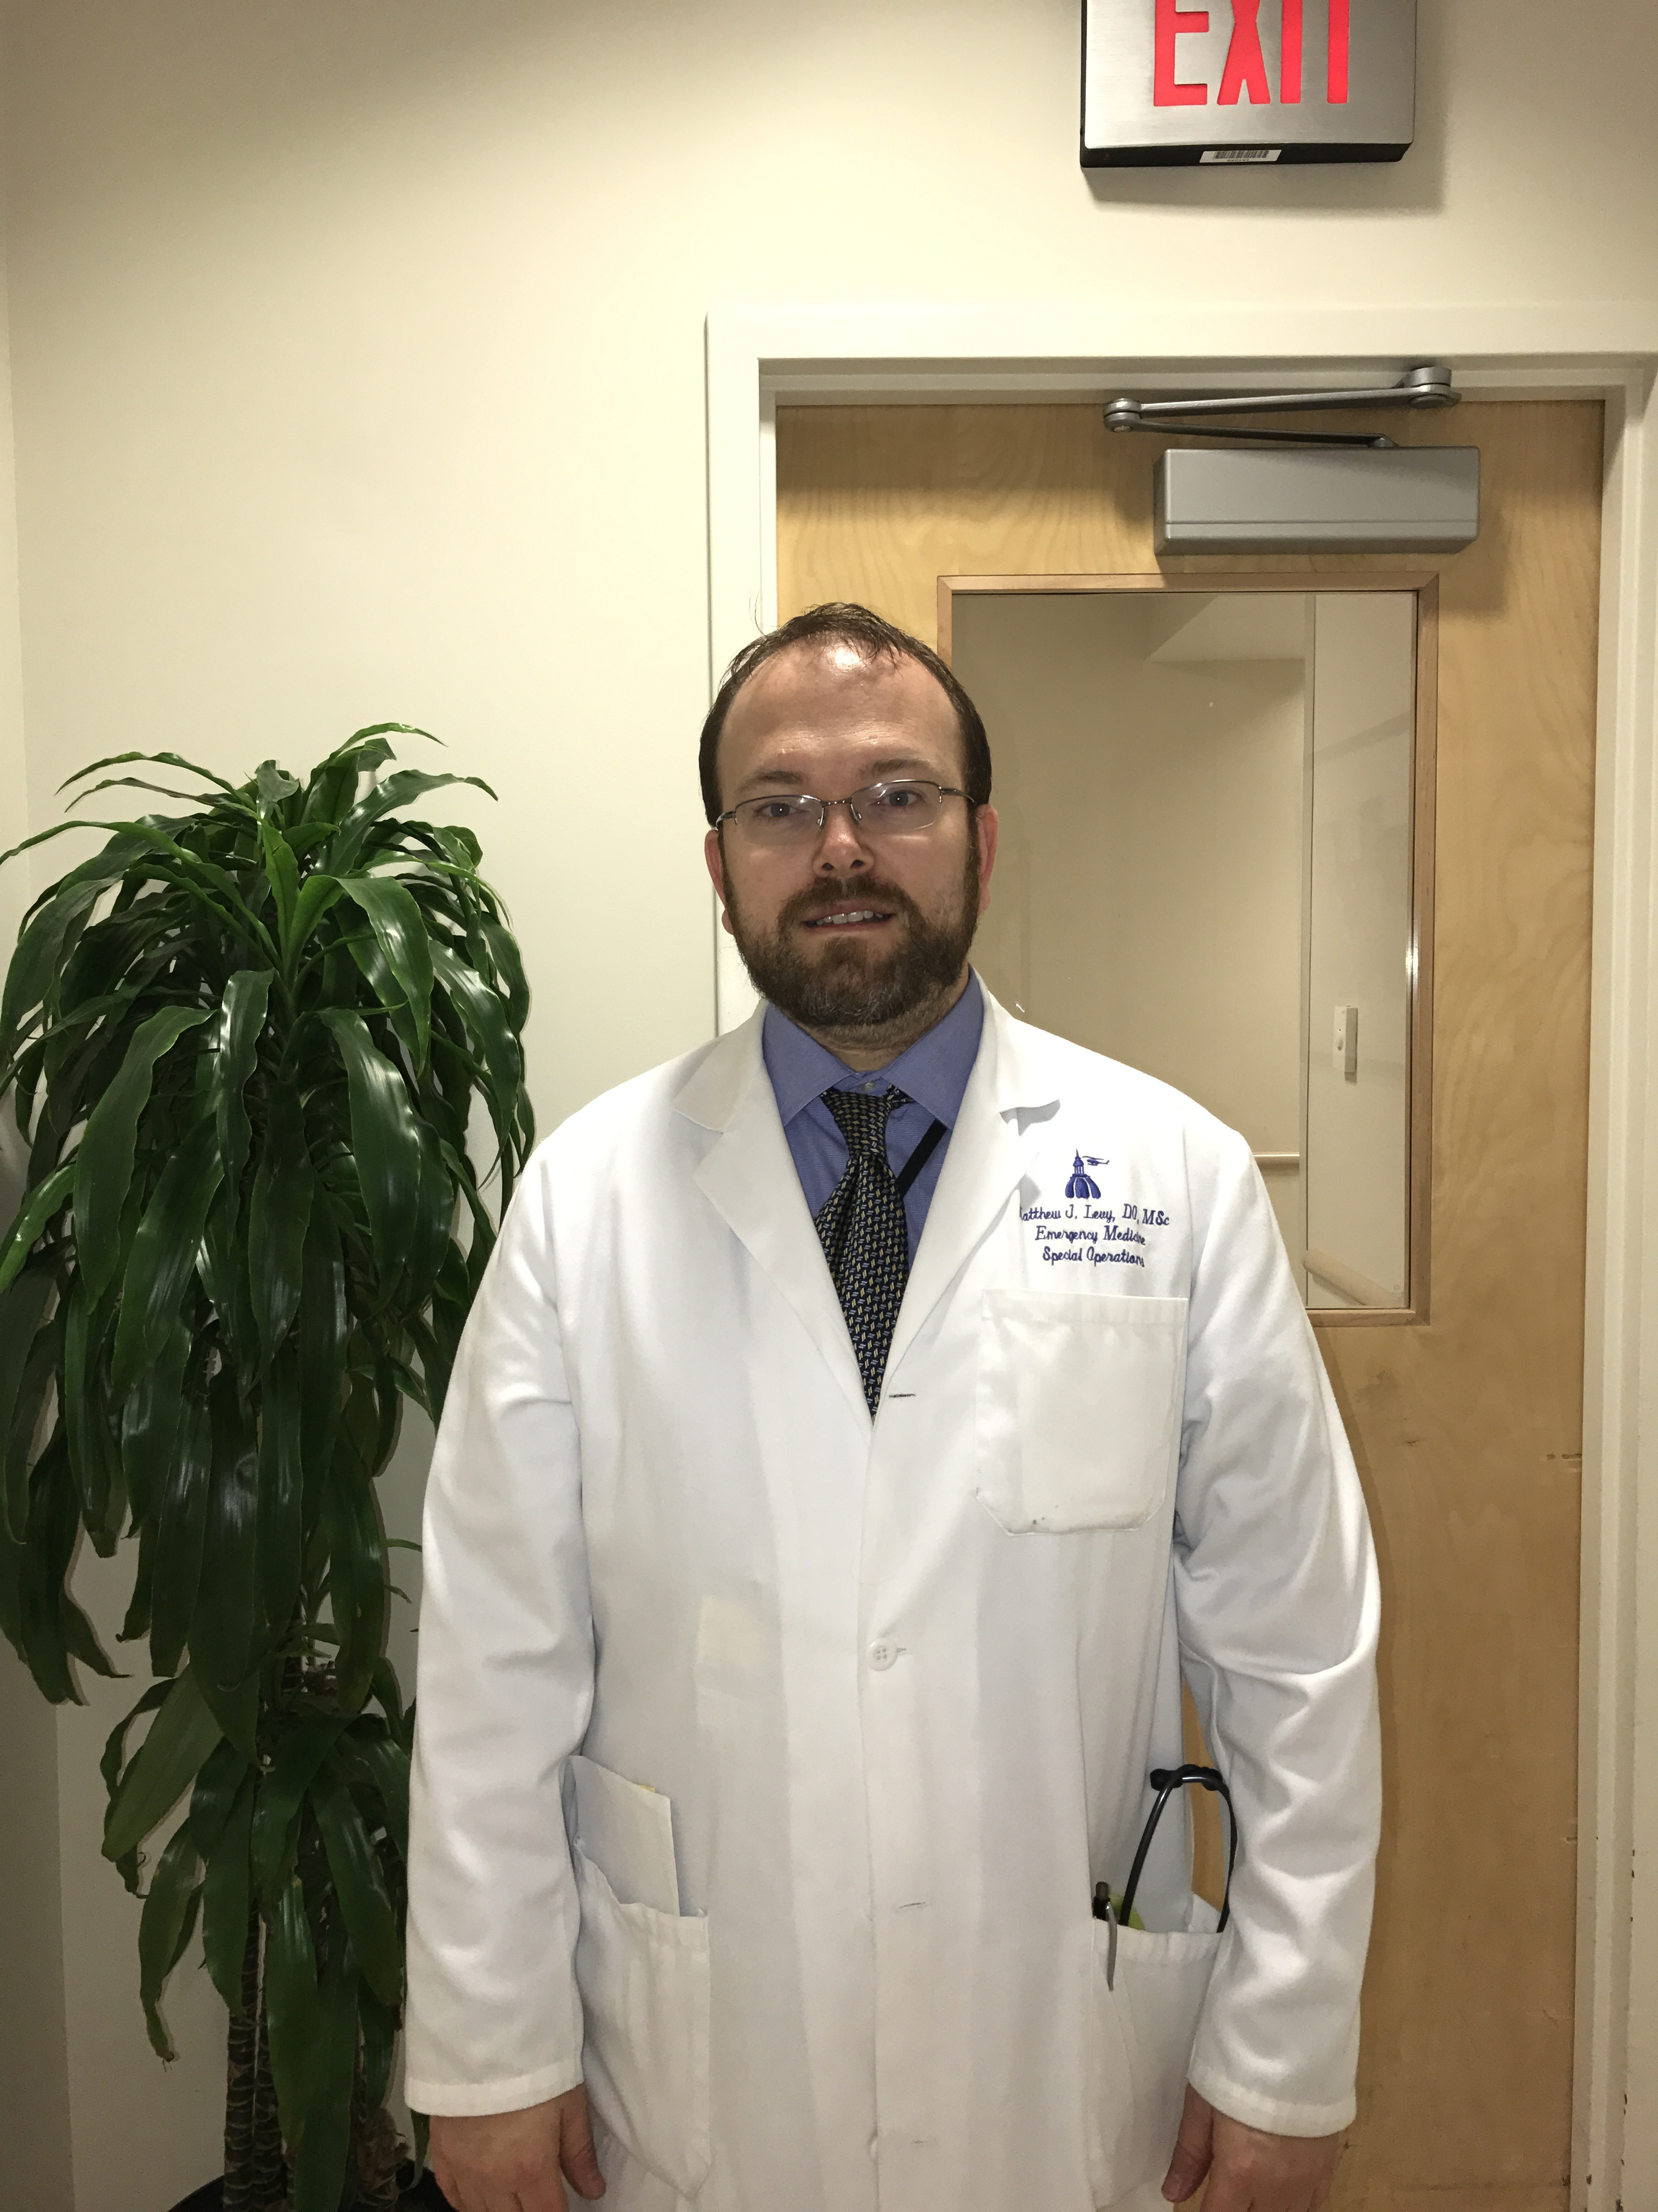
My Background
Board Certified Emergency Medicine and Emergency Medical Services Physician
22 years of experience in prehospital emergency care and preparedness
Faculty at Johns Hopkins University and the University of Maryland Baltimore County
Worked in public and private sectors on issues related to mass gatherings, special events, travel medicine and disaster response
Notes:
Specialize in the out-of-hospital medicine including emergency medical services systems, operational medicine and special event medical support

Slide 4
Today’s Session…
Brief overview of COVID-19
EMS System preparedness
Leadership Moments
Discussion

Slide 5
COVID-19 Overview
Viral respiratory illness
A new virus, not previously seen
Global pandemic
Much more serious than the Flu
Asymptomatic spread is possible
Over 110,000 US deaths
67 deaths in Howard County
Easily spread through respiratory droplets
States of Emergency declared worldwide
Social distancing efforts are key to slowing the spread
Ongoing need to help ensure adequate healthcare capacity
Regions have begun reopening
Social distancing practices and hygienic principles are key
This will be the “new normal” for some time to come
Notes:
Covid-19 is a viral illness that originated in Wuhan City of the Hubei Province in China in December of 2019 and has since become a global pandemic.
Its much more serious than the flu and has a higher mortality rate.
The virus is easily spread from person-to-person through respiratory droplets that are produced when the infected person coughs or sneezes.
More cases are reported every day around the world and here in Maryland.
Unfortunately, we have seen a significant rise in cases since the original case March 5, 2020.
States of Emergency have been declared in our county, state and nation.
We anticipate the need for significantly higher EMS and healthcare resources as the number of patient’s with symptoms increases.
There is serious clinical concern regarding the number of people who might require hospitalization and ICU resources.

Slide 6
COVID-19 Response Planning
Began closely monitoring the situation in early February
Lessons from Washington State
Assembled an internal stakeholder group
Senior leadership
Office of the Medical Director
EMS Operations
Logistics
Finance
Collaboration with other agencies
HCGH; HCHD; MIEMSS; MDH

Slide 7
Clinical Readiness
Close coordination with EMS agencies across the region and with the State EMS Office (MIEMSS)
Establishment of PUI (Person Under Investigation Criteria)
Creation of a special dispatch procedures
Rapid implementation of a new triage protocol for EMS
PUI = Any patient with:
Fever,
- OR-
Shortness of Breath,
- OR-
Flu-like Symptoms
(Sore throat, or congestion, or cough, or new body aches, or diarrhea).

Slide 8
Pandemic Triage Protocol
For use by both ALS and BLS clinicians
Goal:
To identify patients who can safely stay home, and
Help the EMS clinician recognize high-risk criteria
Checklist format
Any grey boxes checked = encourage transport
No grey boxes checked = eligible for no-transport
EMS Clinician has discretion to transport even if no grey boxes are checked
Notes:
This protocol can be used by both ALS and BLS clinicians.
It’s intended to help differentiate between those patients who can safely self manage their care at home from those patients who have high risk criteria and should be transported.
The protocol consists of a checklist that guides the EMS clinician through a series of questions that cover inclusion criteria, high risk conditions, concerning exam findings
If any of the grey boxes are checked, EMS crews shall encourage the patient to be transported to the hospital. If a patient has grey boxes checked and does not wish to be transported to the hospital, the EMS clinician shall follow the Maryland Refusal Protocol
In order to be eligible for this protocol, all checks need to be in the non-shaded boxes. If a patient meets criteria for this no-transport protocol, a refusal is not necessary.
Also, we’d like to remind you that you, as the EMS clinician, has discretion to transport the patient even if no grey boxes are checked.
It is also essential that you get a good phone number for follow up purposes.

Slide 9
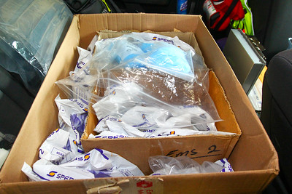
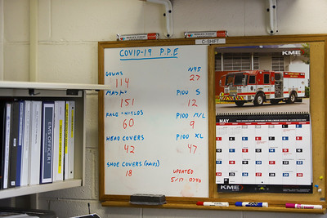
Personal Protective Equipment
Supply chain continuity
Education on proper donning and doffing
Operational considerations

Slide 10
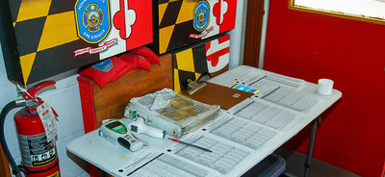
Responder Health & Readiness
Tracking personnel exposures
Support for COVID positive personnel
Health screening and syndromic surveillance
Personal health readiness
Psychological health
Family impact

Slide 11
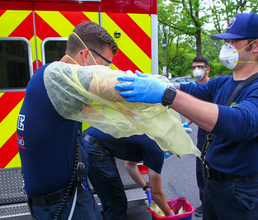
Emergency Medical Services During COVID
Delays in people calling 911
Overall call volume decreased
Severity of illness increased
Heightened complexity in care
Adjustment of clinical protocols
Rapid response teams
24/7 presence in the ED at HCGH
Listening to the concerns of frontline personnel

Slide 12
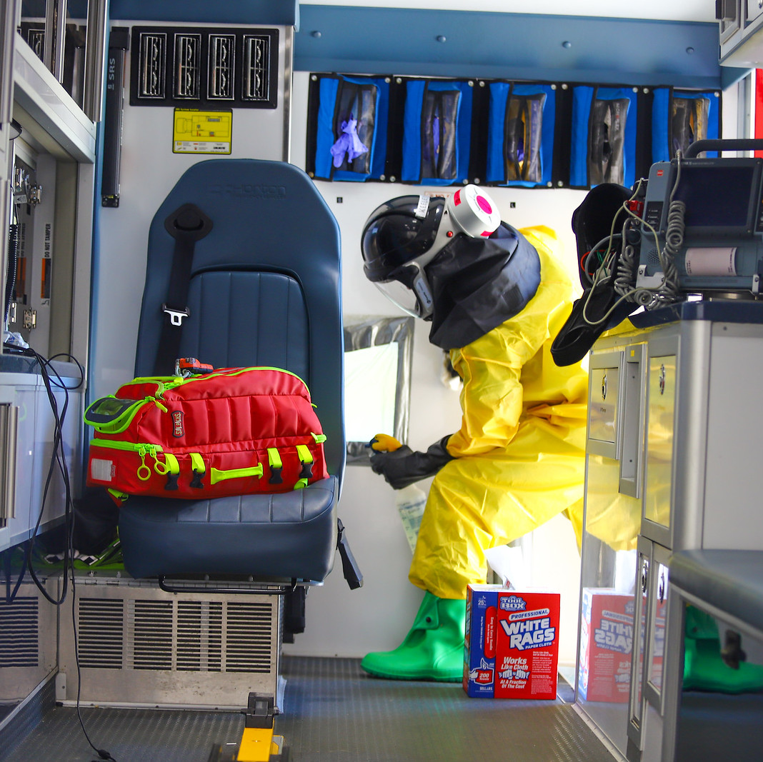
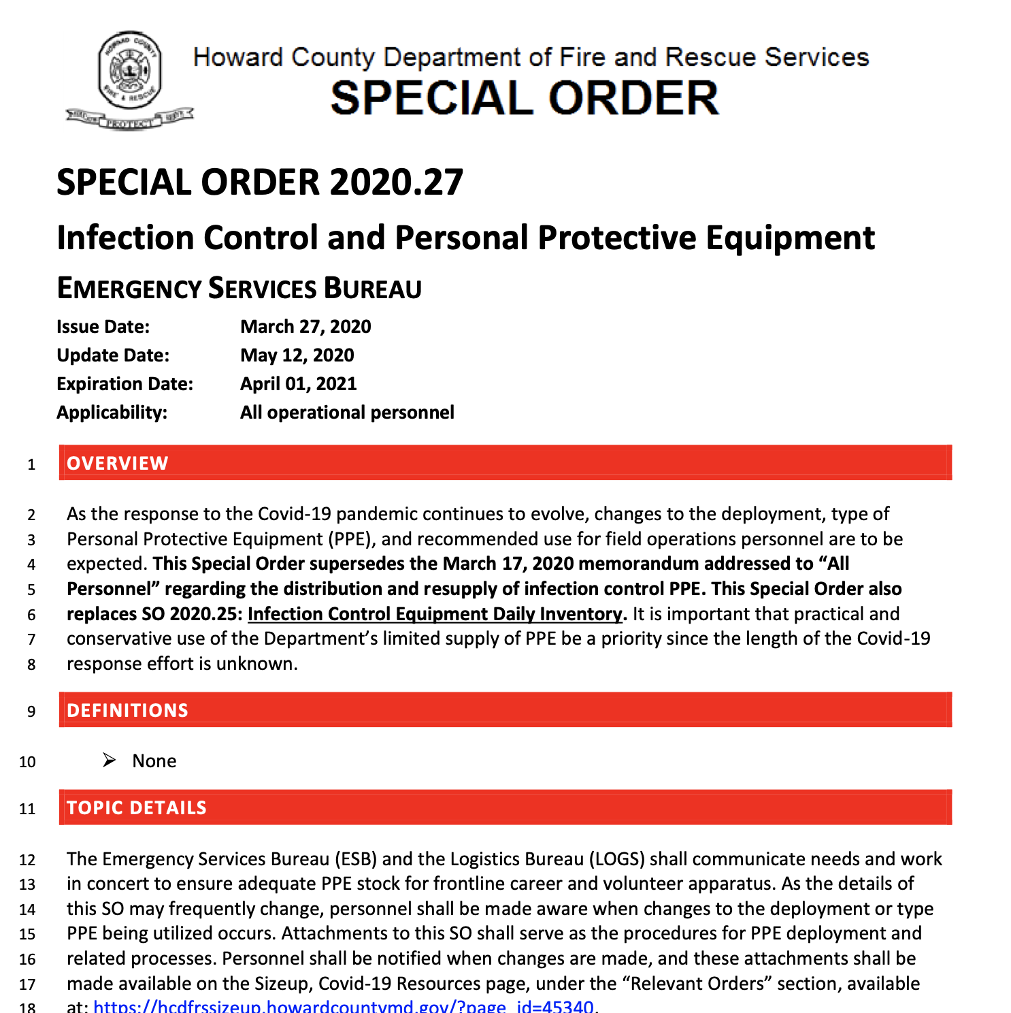
Decontamination and Infection Control
Infection control practices
Hand hygiene
Propper use of PPE
Decontamination team

Slide 13
Countywide Collaboration
Operational and logistical support to HCGH
Very strong relationships with HCGH, HCHD, HCPD, OEM
Ongoing calls, sitreps, information sharing
Maintaining flexibility in planning

Slide 14
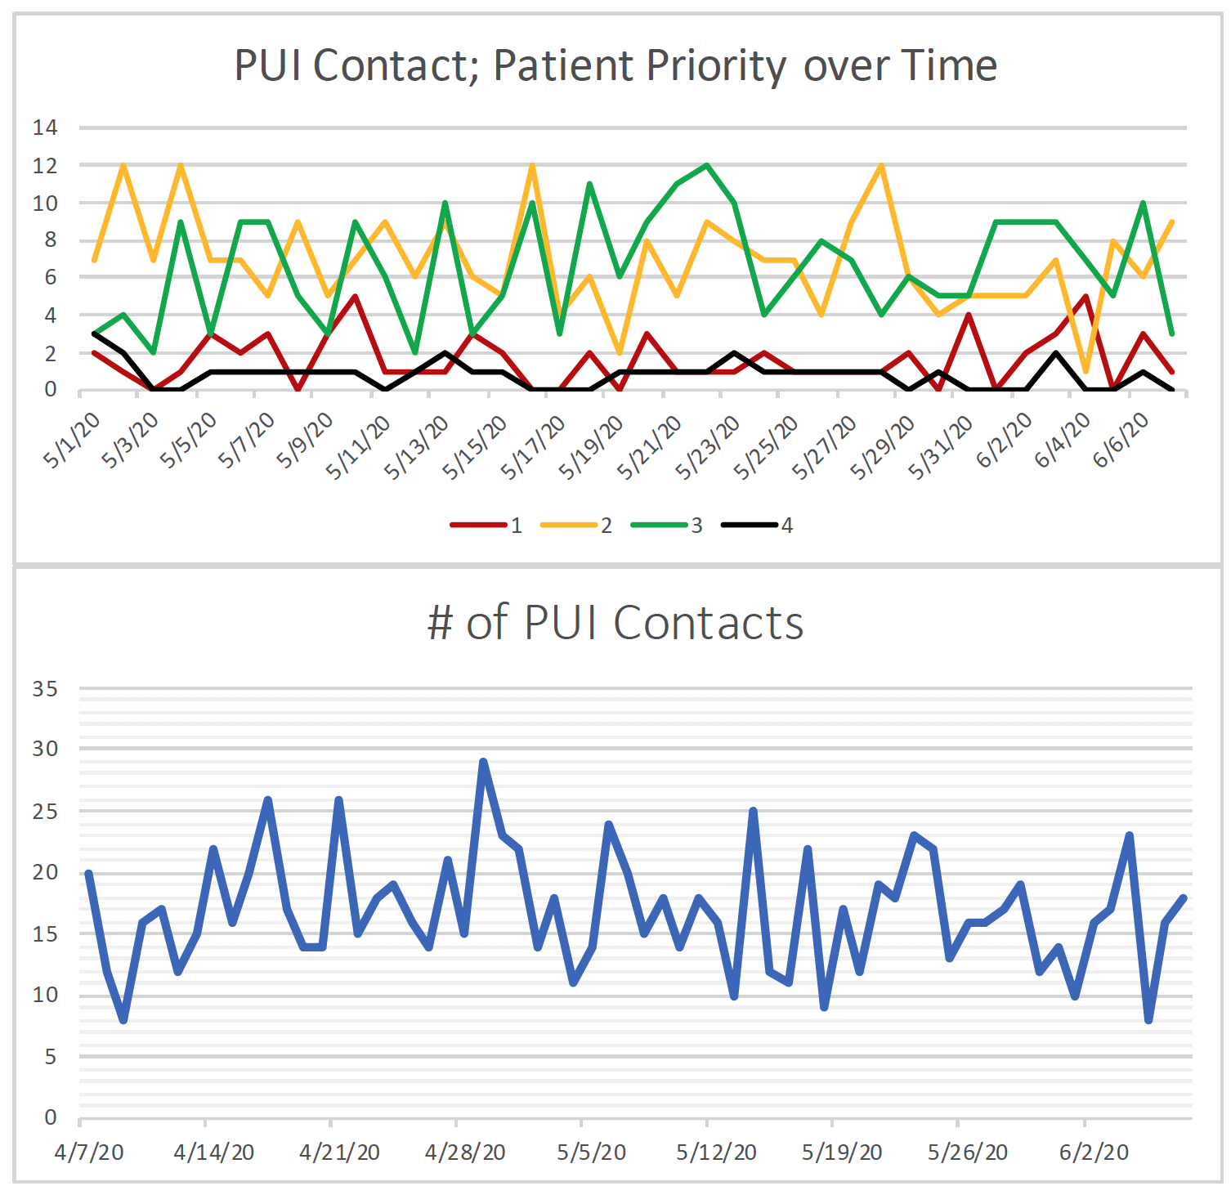
Understanding Our Data
Defining metrics
Establishing key indicators
Understanding trends
Adjusting course when necessary

Slide 15
Discussion

